Slide 1
Transforming Objects
2019 01 12

Slide 2
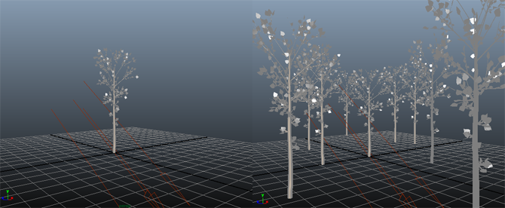
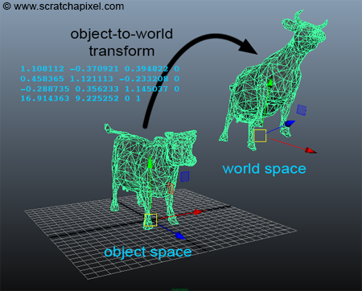
Object space, world space
We change the size, the rotation and the position of object using a 4x4 transformation matrix
That matrix : object-to-world matrix (in OpenGL, model matrix).
Object space world space

Slide 3
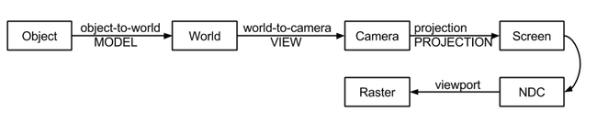
Transformation pipeline
Objects are first transformed from object space to world space.
If rasterization is used, objects are then transform from world-to-camera space.
Vertices are then projected onto the screen (using the perspective projection matrix) to screen space
And then remapped to NDC (as part of the perspective projection matrix).
Finally, points on the image plane in NDC coordinates are converted to their final raster or pixel coordinates.

